Slide 1

Explore the financial landscape of Indian states from 1980 to 2016 with our Excel Dashboard. Uncover trends, compare budgets, and track economic indicators effortlessly. This tool offers comprehensive insights into state finances, empowering informed decision-making and strategic planning. Dive into the data and unlock valuable perspectives today.

Slide 2
SQL PROJECT
ON
Make an Excel Dashboard to analyze the Finances of different states in India through from 1980 to 2016

Slide 3
QUERY
.

Slide 4
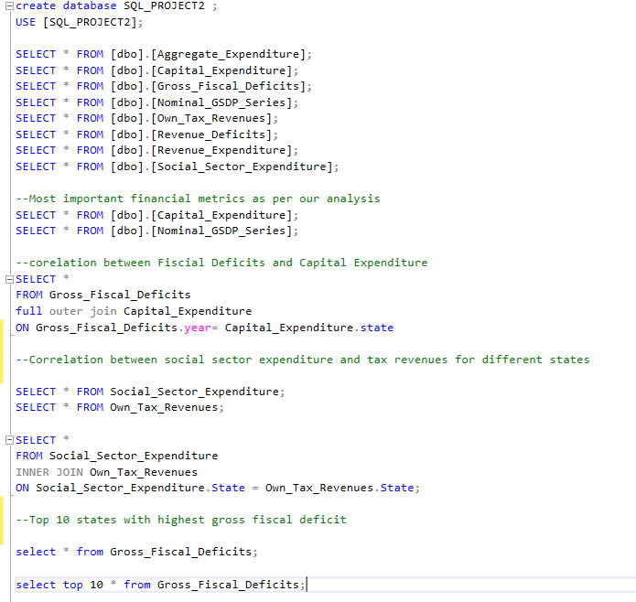

Slide 5
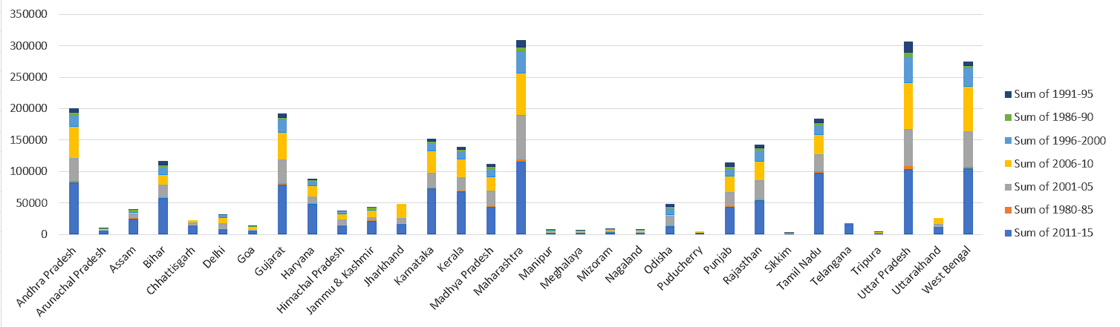
5 year termly analysis of different Financial Metrics

Slide 6
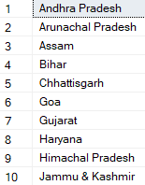
Top 10 states with highest gross fiscal deficit

Slide 7
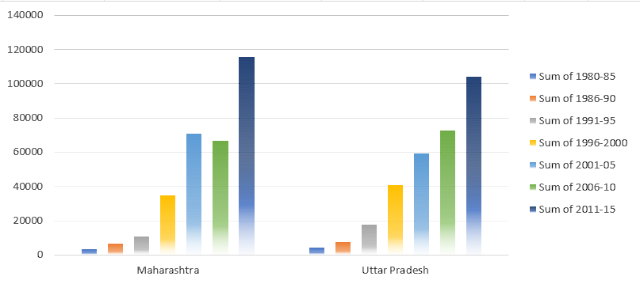
Find out Top 2 states which has continuous 10 year upward trend as well of Nominal GSDP Series and Gross Fiscal Deficits.

Slide 8
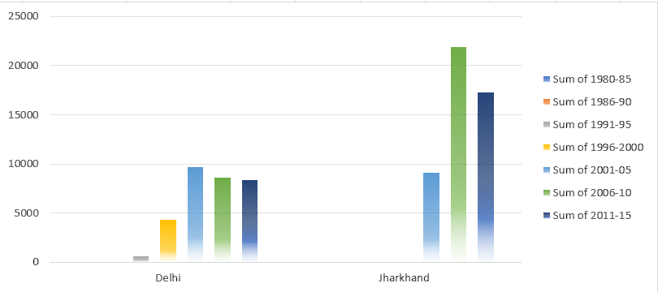
Find out Top 2 states which has continuous 10 year downward trend as well of Nominal GSDP Series and Gross Fiscal Deficits.

Slide 9
Give at least 2 insights that are not mentioned above and are not clearly visible from the data.
Maharashtra has the highest GDP growth rate.
here are the key factors contributing to Maharashtra's high GDP rate in bullet points:
Economic Diversity: Mix of agriculture, manufacturing, services, and trade.
Industrialization: Strong industrial base including textiles, automobiles, chemicals, and IT.
Infrastructure: Well-developed ports, airports, highways, and power supply.
Urbanization: Rapid growth in cities like Mumbai, Pune, Nagpur, and Nashik.
Educational Institutions: Presence of premier institutions like IIT Bombay and University of Mumbai.
Policy Initiatives: Government initiatives like Make in Maharashtra and ease of doing business reforms.

